Slide 1
Performance Enhancement Analysis
Cherry Nguyen
Yutong Dong
Joanna Zhu
Linh Tran
Kristy Lui

Slide 2
Introduction
Who are we?
MBAN Students from UBC Sauder Business School
What was our approach to this event?
Assess the relationship between participation and overall performance (current score)
Determine the relevant factors to increase participation
Visualize the relationships between those factors and engagement level

Slide 3
PARTICIPATION VS OVERALL

Slide 4
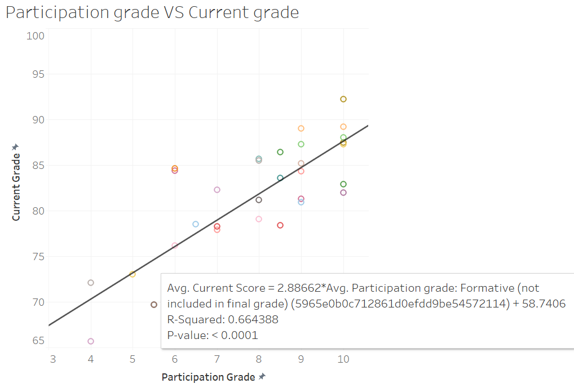
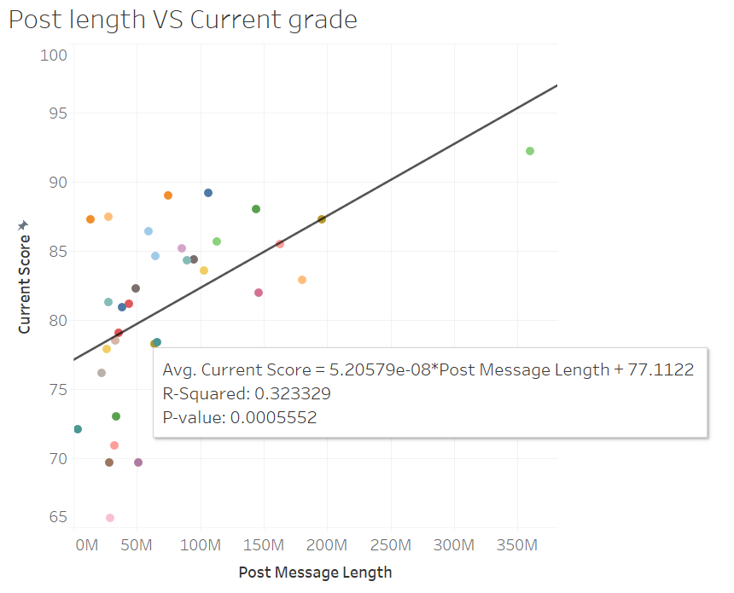
Positive correlation between participation and current grade

Slide 5
HOW DO WE ENCOURAGE MORE PARTICIPATION?

Slide 6
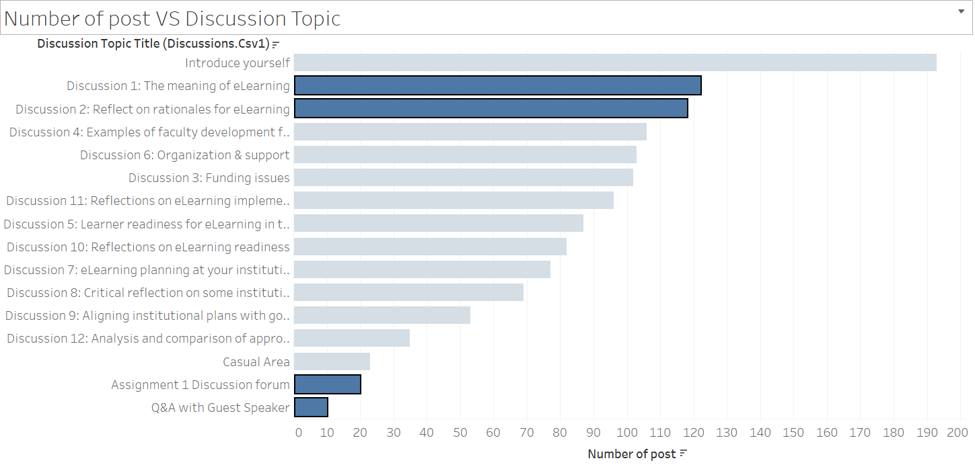
Number of Post Vs Topic Type

Slide 7
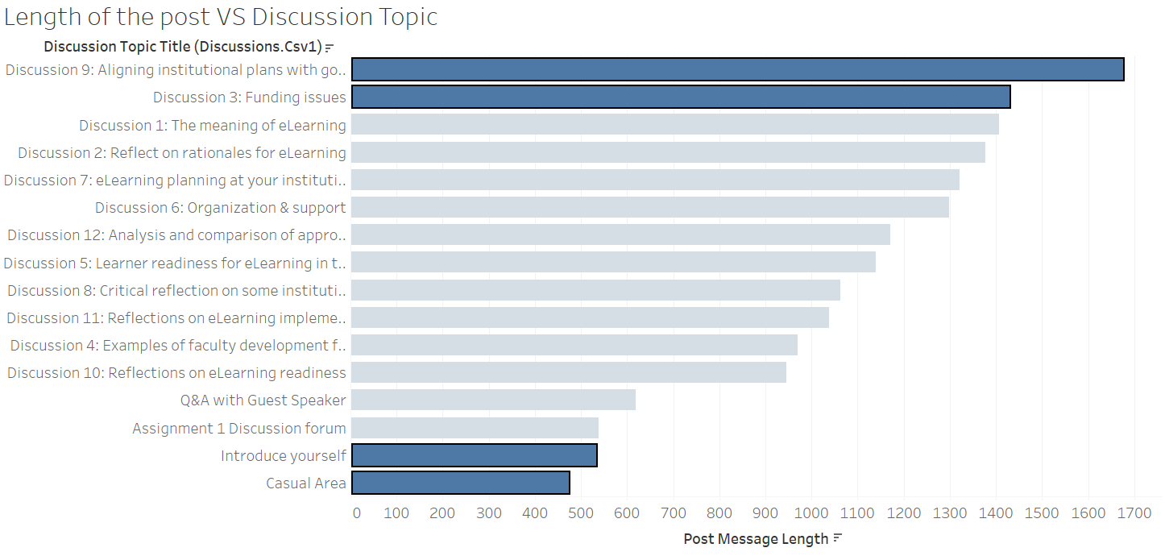
2. Length of Response Vs Topic Type
Notes:
Recommendation #2:
Based on the number of posts for each topic, we recommend the instructors to increase students' participation by posting debatable questions

Slide 8
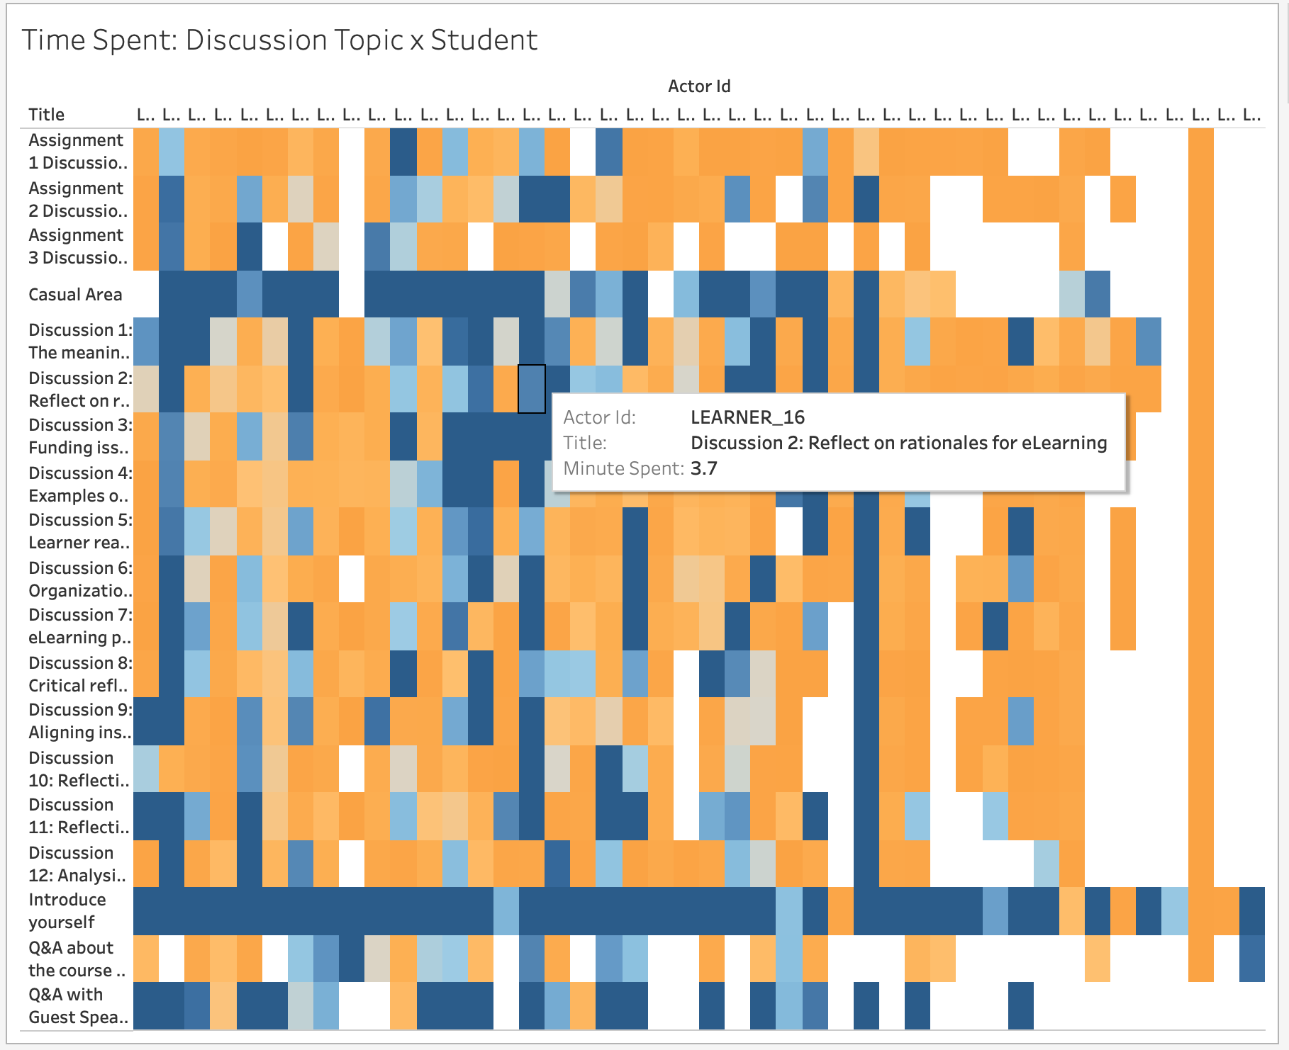
3. Individual participation & interest
Assumption:
Time gap between two navigation event stands for the time the student stay on the page.
For each visit to the discussion board, a student would stay for no more than 30 minutes. (Average staying time is used to replace)
Results:
Highest participation:
Non-academic related topics (Introduce yourself & Casual Area), Guest Speak Q&A, Discussion 1 & 9
Students participation time consists among various topics.

Slide 9
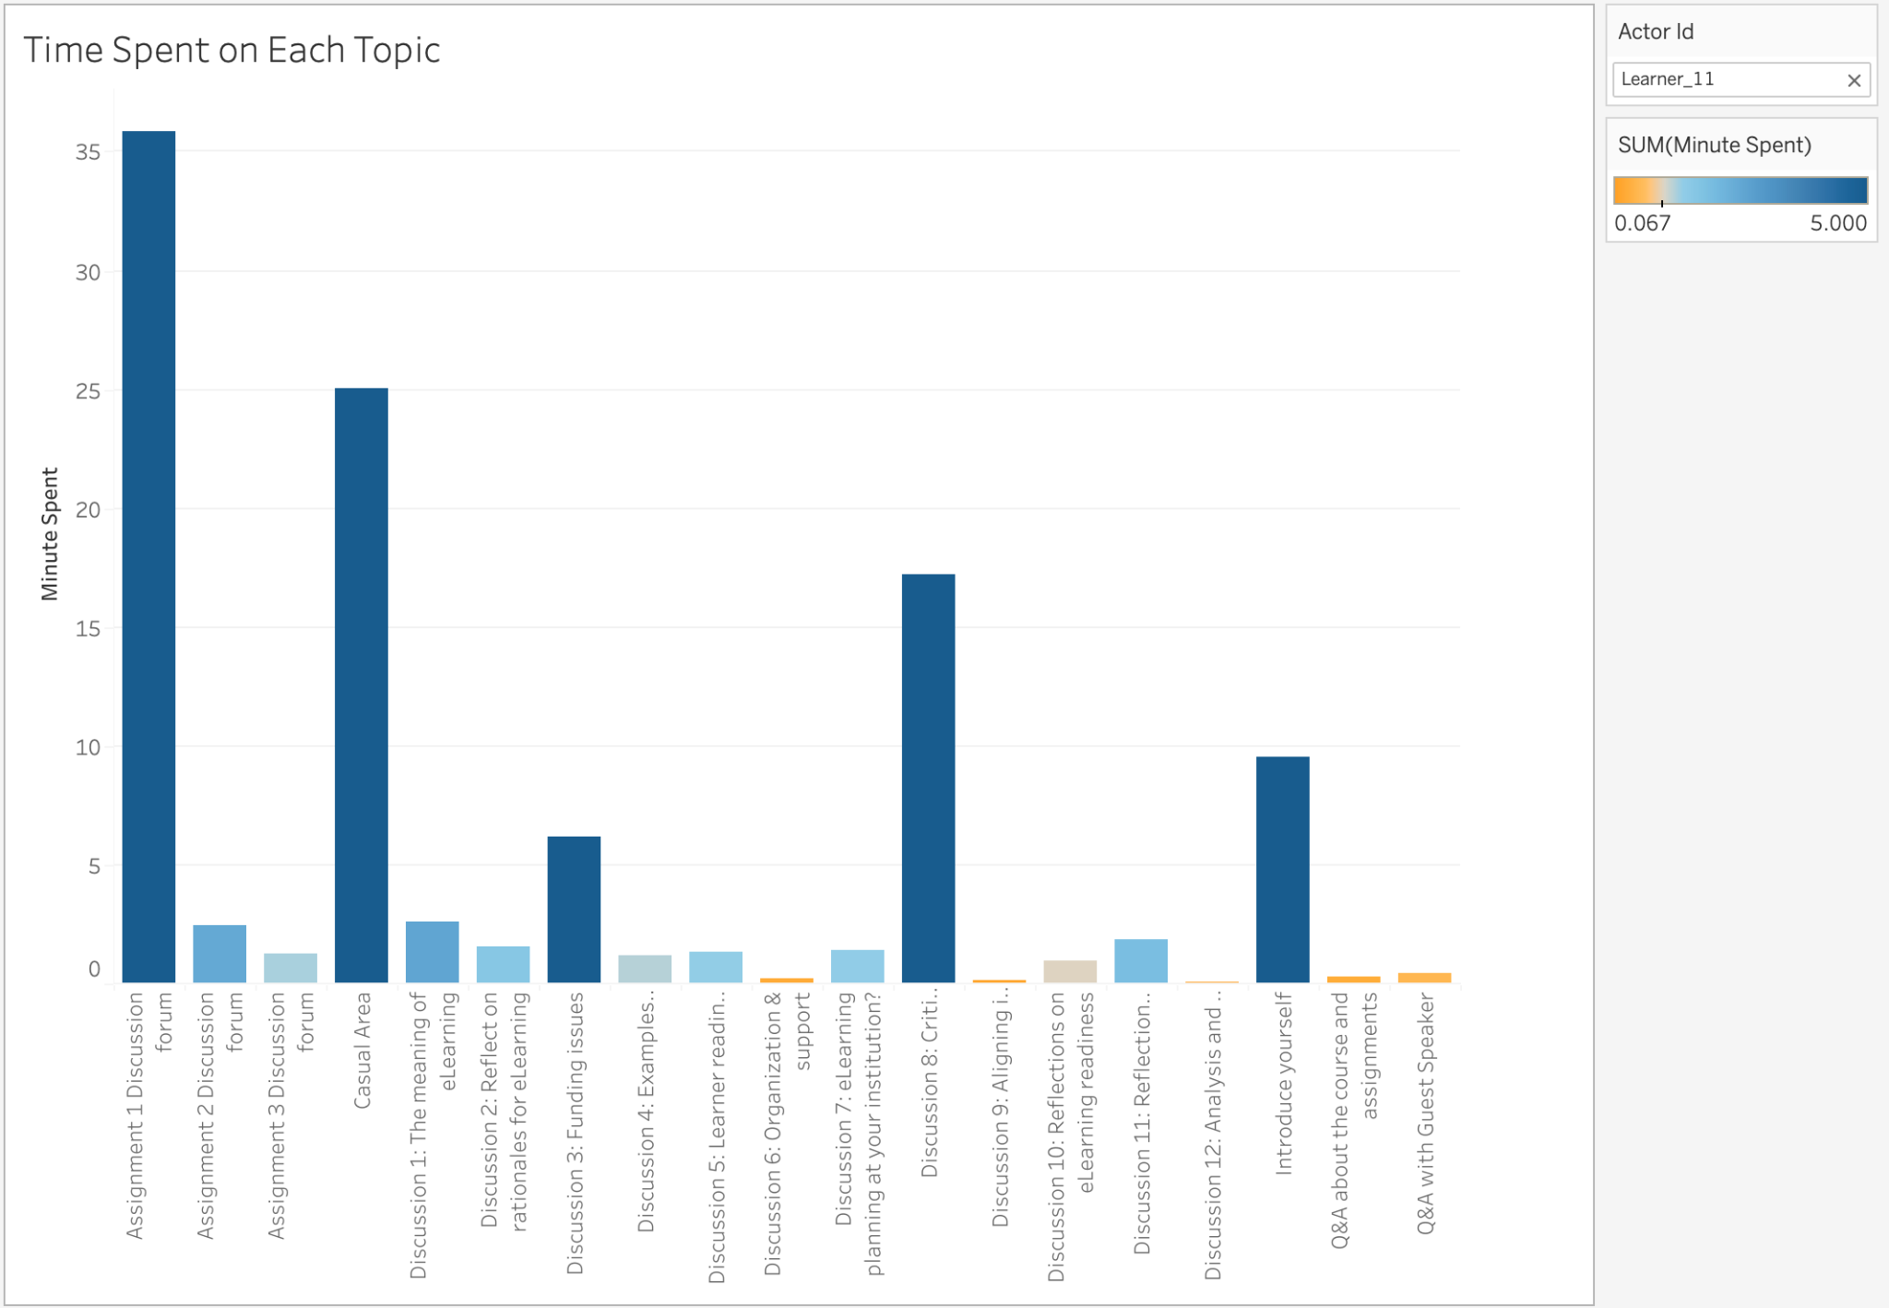

Slide 10
RECOMMENDATIONS AND LIMITATIONS

Slide 11
Recommendations
Limitations
Help instructors to design the syllabus based in discussion topics
Missing values in dataset
Notes:
Our final product helps instructors to come up with the most engaging topics based on time spend, length of the answers and the number of responses when designing their syllabus in order to increase the students' participation and their overall performance.
Our limitation is mainly related to the quality of the dataset. There are areas that we want to look into but because we don't have enough data or the data do not make sense so we cannot understand why certain patterns happen. For example, the discussions for Assignment 2 and 3 don't have any responses at all while the discussion for Assignment 1 receives replies throughout the 4 months.

